Slide 1
Orlando Florida
Traveling June 8-15 2013
Planned By:
Andres
giraldo

Slide 2
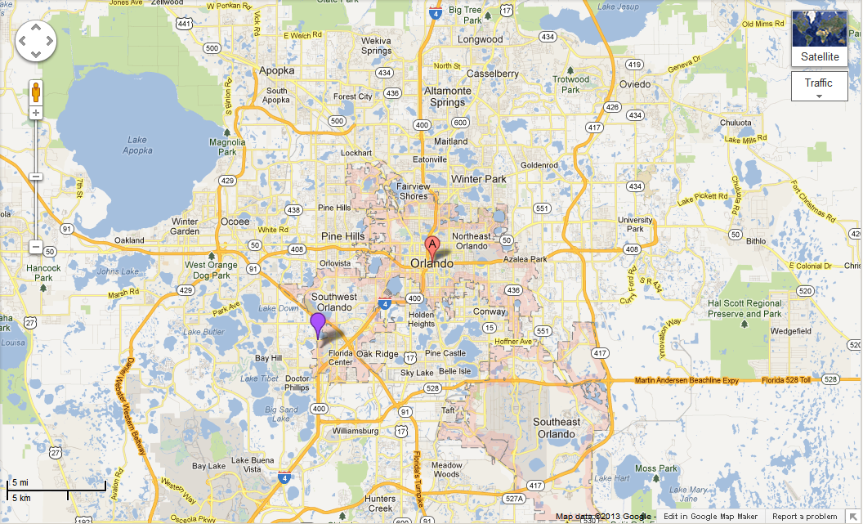
Map

Slide 3
Transportation
Transportation | Budget
Airfare x (family) | $0.00
Airfare Parking at Airport | $0.00
Car Rental | $90.00
Gas (going) [price x 25/ MPG] | $0.00
Gas (coming home) [price x 25/ MPG] | $32.00
Bus Tickets | $0.00
Train | $0.00
Other | $0.00
Total | $2880.00
Figure out gas:
Find miles (google Maps)
Divide miles by 25
Take that number x gas price

Slide 4
Lodging
Lodging | Budget
Hotels $ x how many nights Not staying in the same place? Sunday Monday Tuesday Wednesday Thursday Friday Saturday | $0.00
Other | $0.00
Total | $0.00

Slide 5
Extra Expense
Extra expenses | Budget
Souvenirs ($0.00 x # of people) x # of purchases | $0.00
Snacks ($0.00 x # of people) x # of purchases | $0.00
Emergency cash | $0.00
Total | $0.00

Slide 6
Itinerary
Total Expense: $0.00
Saturday, June 8th | Where | How Much?
Breakfast | home | $0.00
Activity | play | $0.00
Lunch | home | $0.00
Activity | play | $0.00
Dinner | home | $0.00
Activity | play | $0.00

Slide 7
Itinerary
Total Expense: $12.00
Sunday, June 9th | Where | How Much?
Breakfast | home | $0.00
Activity | Packed And leved | $0.00
Lunch | Mc donaeld 3x | $10.00
Activity | Play kindle In car | $0.00
Dinner | hotel | $2.00
Activity | Play kindle | $0.00

Slide 8
Itinerary
Total Expense: $60.00
Monday, June 10th | Where | How Much?
Breakfast | hotel | $3.00
Activity | beach | $0.00
Lunch | Red robin 3x | $21.00
Activity | pool | $0.00
Dinner | hotel | 39.00
Activity |  | $0.00

Slide 9
Itinerary
Total Expense: $142.00
Tuesday, June 11th | Where | How Much?
Breakfast | hotel | $3.00
Activity | Universal studio 3x | $100.00
Lunch | At univesal studio | $0.00
Activity | Universal studio | $0.00
Dinner | hotel | $39.00
Activity |  | $0.00

Slide 10
Itinerary
Total Expense: $42.00
Wednesday, June 12th | Where | How Much?
Breakfast | hotel | $3.00
Activity | beach | $0.00
Lunch | At beach | $0.00
Activity | beach | $0.00
Dinner | hotel | $39.00
Activity |  | $0.00

Slide 11
Itinerary
Total Expense: $84.00
Thursday, June 13th | Where | How Much?
Breakfast | hotel | $3.00
Activity | beach | $0.00
Lunch | Red robin 3x | $75.00
Activity | BEACH | $0.00
Dinner | HOTEL 3x | $39.00
Activity |  | $0.00

Slide 12
Itinerary
Total Expense: $44.00
Friday, June 14th | Where | How Much?
Breakfast | holtel | $2.00
Activity | pack | $0.00
Lunch | Sandwich 3 for each | $32.00
Activity | beach | $0.00
Dinner | mcdonanlds 3x | 10.00
Activity | drive | $0.00

Slide 13
Itinerary
Total Expense: $0.00
Saturday, June 15th | Where | How Much?
Breakfast | mcdonalds | $ 5.00
Activity | drive | $0.00
Lunch | snacks | $0.00
Activity | Play kindle | $0.00
Dinner | Fried cicheken | 10.00
Activity | Play kindle | $0.00

