Slide 1
Hilton Head, South Carolina $4,608.00
Traveling June 8-15 2013
Planned By:
Anna Dover

Slide 2
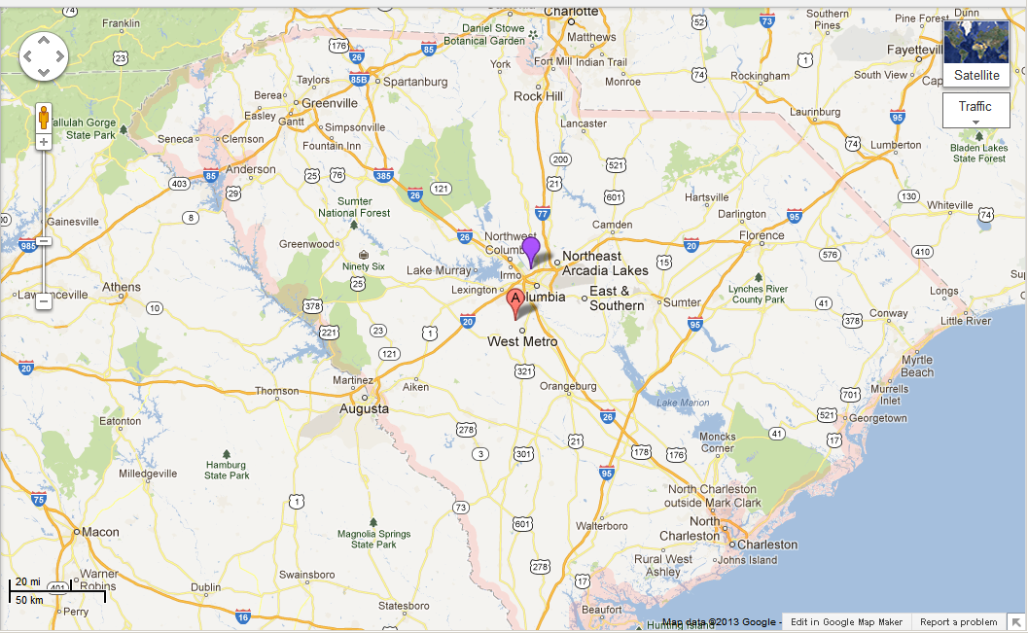
Map

Slide 3
Transportation
Transportation | Budget
Airfare x (family)145x4 | $580.00
Airfare Parking at Airport | $0.00
Car Rental | $0.00
Gas (going) [price x 25/ MPG] | $0.00
Gas (coming home) [price x 25/ MPG] | $0.00
Bus Tickets | $0.00
Train | $0.00
Other | $0.00
Total | $0.00
Figure out gas:
Find miles (google Maps)
Divide miles by 25
Take that number x gas price

Slide 4
Lodging
Lodging | Budget
Hotel $ How many night Bareny Beach Club Not staying in the same place? Sunday Monday Tuesday Wednesday Thursday Friday Saturday | $375.00
Other | $0.00
Total | $2,250.00

Slide 5
Extra Expense
Extra expenses | Budget
Souvenirs $10.00 x 4 x 4 purchases | $40.00
Snacks ($5.00 x 4 people) x # of purchases | $105.00
Emergency cash | $250.00
Total | $395.00

Slide 6
Itinerary
Total Expense: $696.00
Saturday, June 8th | Where | How Much?
Breakfast | At home | $0.00
Activity | Flying on the plane
Lunch | At airport | $52.00
Activity | Get smoothies 6x4 | $24.00
Dinner | Hudson's Seafood 10x4 | $40.00
Activity | Play on Beach | $0.00

Slide 7
Itinerary
Total Expense: $160.00
Sunday, June 9th | Where | How Much?
Breakfast | Waffle House 10x4 | $40.00
Activity | Play at the pool at Hotel | $0.00
Lunch | In Hotel | $0.00
Activity |  | $0.00
Dinner | Sea Shack 20x4 | $80.00
Activity | Mini Golf | $40.00

Slide 8
Itinerary
Total Expense: $112.00
Monday, June 10th | Where | How Much?
Breakfast | In hotel | $0.00
Activity | Ride Bikes 5x4 | $20.00
Lunch | In hotel | $0.00
Activity | Ride Bikes | $0.00
Dinner | Salty Dog Café 15x4 | $60.00
Activity | Movie | $32.00

Slide 9
Itinerary
Total Expense: $128.00
Tuesday, June 11th | Where | How Much?
Breakfast | In hotel | $0.00
Activity | Play on beach | $0.00
Lunch | Pizza And Wings 12x4 | $48.00
Activity | Play on beach | $0.00
Dinner | Hugo`s Seafood 20x4 | $80.00
Activity | Rest in Hotel | $0.00

Slide 10
Itinerary
Total Expense: $140.00
Wednesday, June 12th | Where | How Much?
Breakfast | Truffles Café 17x4 | $68.00
Activity | Play on beach | $0.00
Lunch | In hotel | $0.00
Activity | Play on beach | $0.00
Dinner | Dry Dock 8x4 | $32.00
Activity | Shopping 10x4 | $40.00

Slide 11
Itinerary
Total Expense: $10.00
Thursday, June 13th | Where | How Much?
Breakfast | At Hotel | $0.00
Activity | Water Slide at Pool | $0.00
Lunch | At Hotel | $0.00
Activity | Play on the Beach | $0.00
Dinner | Pizza Café 1 big pizza | $10.00
Activity | TV at hotel | $0.00

Slide 12
Itinerary
Total Expense: $140.00
Friday, June 14th | Where | How Much?
Breakfast | Waffle House 15x4 | $60.00
Activity | Play on the beach | $0.00
Lunch | In hotel | $0.00
Activity | Ice cream 5x4 | $20.00
Dinner | Crazy crab 10x4 | $40.00
Activity | Movie 5x4 | $20.00

Slide 13
Itinerary
Total Expense: $52.00
Saturday, June 15th | Where | How Much?
Breakfast | At hotel | $0.00
Activity | Flying on the plane
Lunch | At airport 13x4 | $52.00
Activity | Drive home | $0.00
Dinner | At home | $0.00
Activity | Unpack | $0.00

