Slide 1
Sevierville TN
Traveling June 8-15 2013
Planned By:
Katie Gray

Slide 2
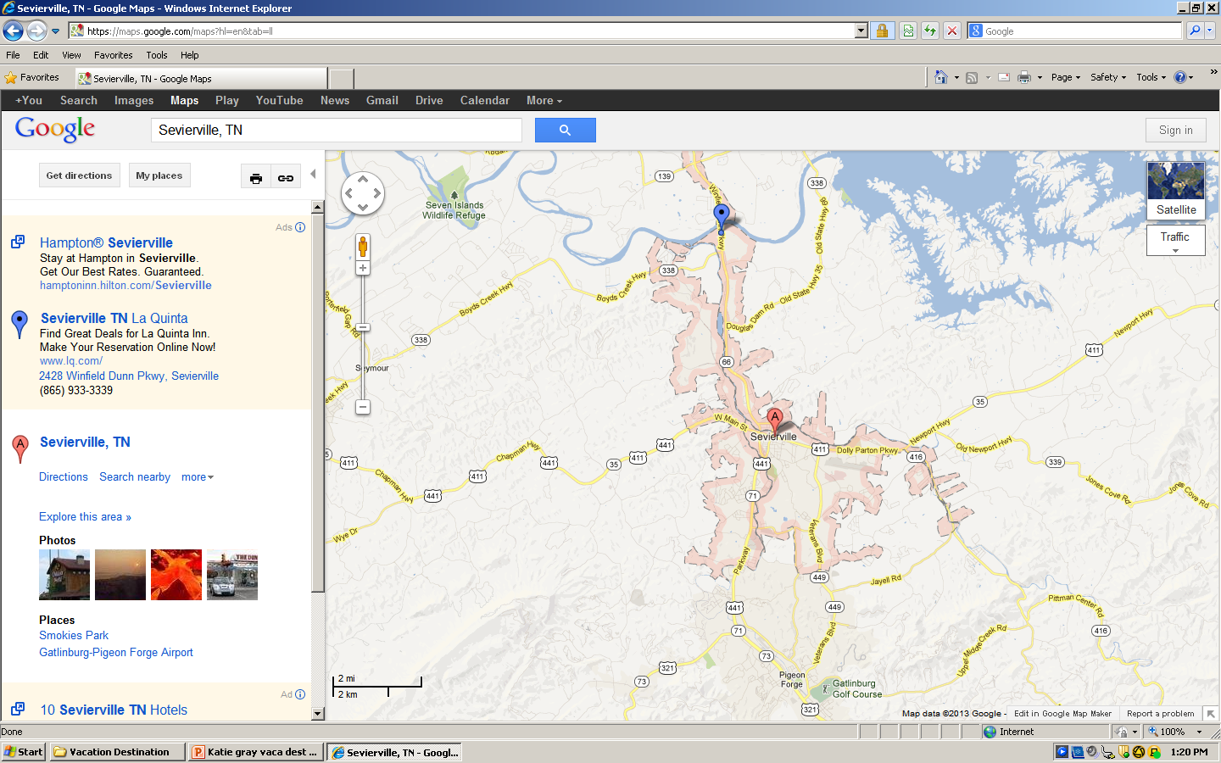
Map

Slide 3
Transportation
Transportation | Budget
Airfare x (family) | $0.00
Airfare Parking at Airport | $0.00
Car Rental | $0.00
Gas (going) 3.324 x 25/ MPG] | $83.1
Gas (coming home) [3.324 x 25/ MPG] | $83.1
Bus Tickets | $0.00
Train | $0.00
Other | $0.00
Total | $166.
Figure out gas:
Find miles (google Maps)
Divide miles by 25
Take that number x gas price

Slide 4
Lodging
Lodging | Budget
Whyndham Resorts $175.00 x 6 Not staying in the same place? Sunday Monday Tuesday Wednesday Thursday Friday Saturday | $1050.00
Other Home | $0.00
Total | $1050.00

Slide 5
Extra Expense
Extra expenses | Budget
Souvenirs ($15.00x 3 people) x 11 purchases | $495.00
Snacks ($5.50 x 4 people) x 2 purchases | $44.00
Emergency cash | $300.00
Total | $939.00

Slide 6
Itinerary
Total Expense: $0.00
Saturday, June 8th | Where | How Much?
Breakfast | Eat at home | $0.00
Activity | Watch TV | $0.00
Lunch | Eat at home | $0.00
Activity | Play outside | $0.00
Dinner | Eat at home | $0.00
Activity | Play the computer | $0.00

Slide 7
Itinerary
Total Expense: $250.75
Sunday, June 9th | Where | How Much?
Breakfast | Eat at home | $0.00
Activity | Sit in the car | $0.00
Lunch | Already packed sandwiches | $0.00
Activity | Sit in the car | $0.00
Dinner | Grocery store visit | $250.75
Activity | pool | $0.00

Slide 8
Itinerary
Total Expense: $45.50
Monday, June 10th | Where | How Much?
Breakfast | Eat at hotel | $0.00
Activity | Pool Put Put golf | $0.00
Lunch | O’charles 4 X 13.00 | $45.50
Activity | pool | $0.00
Dinner | Eat at hotel | $0.00
Activity | pool | $0.00

Slide 9
Itinerary
Total Expense: $250.50
Tuesday, June 11th | Where | How Much?
Breakfast | Eat at hotel | $0.00
Activity | shopping | $66.50
Lunch | Fudruckers 4 X 15.00 | $45.00
Activity | Treasure hunt mini golf | $132.00
Dinner | Eat at hotel | $0.00
Activity | pool | $0.00

Slide 10
Itinerary
Total Expense: $0.00
Wednesday, June 12th | Where | How Much?
Breakfast | Eat at hotel | $0.00
Activity | Put put golf | $0.00
Lunch | Eat at hotel | $0.00
Activity | pool | $0.00
Dinner | Eat at hotel | $0.00
Activity | pool | $0.00

Slide 11
Itinerary
Total Expense: $80.00
Thursday, June 13th | Where | How Much?
Breakfast | Eat at apple barn 5 X 16.00 | $80.00
Activity | Sit in car | $0.00
Lunch | Eat at Dad’s house | $0.00
Activity | Watch TV | $0.00
Dinner | Eat atDad’s house | $0.00
Activity | Watch TV | $0.00

Slide 12
Itinerary
Total Expense: $51.00
Friday, June 14th | Where | How Much?
Breakfast | Eat at Dad’s house | $0.00
Activity | Play computer | $0.00
Lunch | Eat at Dad’s house | $0.00
Activity | Go watch Iron Man 3 18.00 X 2 + 15.00 | $51.00
Dinner | Eat at Dad’s house | $0.00
Activity | Watch TV | $0.00

Slide 13
Itinerary
Total Expense: $0.00
Saturday, June 15th | Where | How Much?
Breakfast | Eat at Dad’s house | $0.00
Activity | Sit in car | $0.00
Lunch | Eat at home | $0.00
Activity | Play on the computer | $0.00
Dinner | Eat at home | $0.00
Activity | Watch TV | $0.00

